Slide 1
Coordination skills
Ability to accurately implement complex spatio-temporal structures of motion. This motor ability is closely linked to the problems of motor control and regulation (Chytráčková, 1988)
The ability to bring the actual course of movement closer to the model (ideal) shape. Ability to solve the spatial and temporal structure of motion.

Slide 2
Taxonomy of motor abilites
Motor abilities
Fitness
Coordination
Hybrid
Strong
Endurance
Speed (realization)
Flexbility
Orientation
Diffrentation
Reaction
Rhytmic
Balance
Association
Rebuild

Slide 3
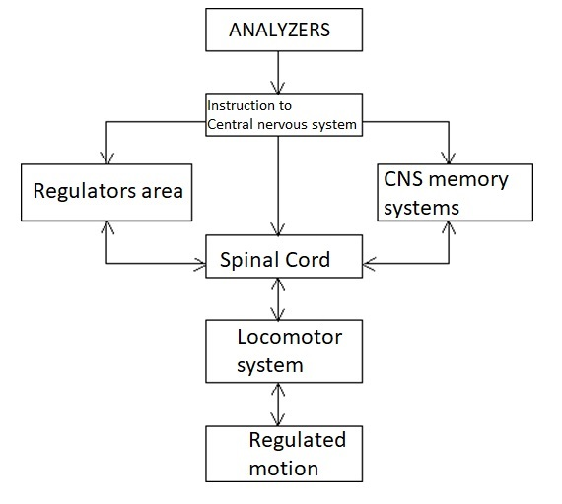
KS structure

Slide 4
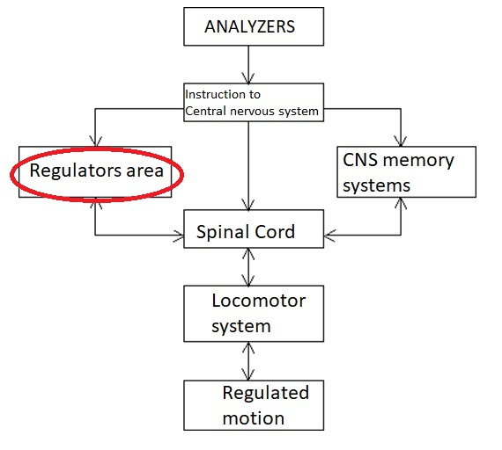
Regulators area
differentiation sch.
indicative sch.
equilibrium sch.
reactionary sch.
rhythmic sch.
other skills (docility, anticipation…)

Slide 5
Regulated system area (locomotor system)
force assumptions
joint mobility
flexibility
optimal activity of the reflex system

Slide 6
Regulated movement area
ability to associate
ability to rebuild
ability to solve the time structure of movement (timing)

Slide 7
Biological basis of KS

Slide 8
Biological basis of KS
Analyzers Type I:
(a) visual
b) auditory
c) vestibular
d) kinesthetic
E) somatosensory
f) time
Analyzers Type II:
a) muscle spindles
b) Golgi bodies
c) Ruffini bodies
d) Paccini bodies
e) joint receptors

Slide 9
KS diagnostics laboratory X field
individual components (differential, equilibrium, rhythmic, orientational)
overall KS testing:
1) complexity of movement
2) accuracy of movement
3) speed of completion of the assigned movement task
4) docility (docility)
5) retention

Slide 10
Overview of basic motor tests:
Speed ​​performance: running with a disc, set with a bar, 4x10 test with met
Balanced with.: cephalography, stability, endurance in a single-legged stand
Rhythmic s .: rhythm chart, non - rhythmic drumming, skipping ropes in const. time
Orienteering - vertical jump with maximum angle, basket shooting
Reaction - reactometry
Association - repeated assembly with a rod

Slide 11
General principles of KS development
1) high volume of repetitions, reasonable intensity, at a high quality level
2) from the simplest to the most complex exercises (boiler .... double somersault)
3) from constant conditions to variable ones (inside, outside, or after various elements)
4) perform exercises in various variations (boiler in 100 ways)
5) practice combinations of previously mastered and perfectly mastered elements (links)
6) perform exercises under pressure (time pressure, decision making, ...)
7) exercises with additional information: limiting or, conversely, enhancing the function of one of the analyzers (blindfolded exercises, more complex exercises - asymmetrical movements in front of the mirror).

Slide 12
Development methods
analytical
contrast
repetition
alternating
sensory

Slide 13
Flexibility
Ability to realize movement in the appropriate range, with full amplitude (Měkota 2005)
Division:
Static
Dynamic
Active
Passive
Terms:
Flexibility and Flexibility
Hyper X Hypombility

Slide 14
The importance of flexibility
successful mastery of movement technique
greater economy of movement
aesthetic form of movement expression in some sports
less likely to be injured or injured
prevention of posture defects
affecting other motor skills
smooth physical activities in everyday life (Pistotnik, 1998)

Slide 15
Biological prerequisites
agonist X antagonist
reciprocal innervation
skeletal muscle proprioceptors - Golgi bodies and muscle spindles

Slide 16
Flexibility development methods
M. active dynamic exercises
M. active static exercise
M. passive dynamic exercises
M. passive static exercise
M. contraction-relaxation-stretching
Stretching - active, dynamic, static, passive: 3 PHASES

Slide 17
Principles for stretching by active static exercise
Warm up (5 min)
Release
Disabling the anti-gravity function
Pain = pathological burden from the periphery
Slowly, pull
Constant free control, targeting.
Stamina
Antagonist contractions (reciprocal innervation)

Slide 18
Diagnostics
trigonometry
distance measurement
scaling
motor tests - binary testing
physiological standard (hypo-, hypermobility)

Slide 19
Research links ....
Excessive flexibility can contribute to the deterioration of the running economy
Relaxation contraction methods are more appropriate to improve flexibility
than "ballistic" stretching
Stretching does not reduce muscle soreness or prevent injury
Do not stretch (only) before explosive force activities
Static stretching reduces strength performance
Stretching reduces the throwing speed
Stretching problems - myths and theories
Neuromuscular functions are affected by the availability of carbohydrates

