Slide 1

Speed ​​ability (speed, speed)
Ability to perform a motor activity or perform a certain movement task in the shortest possible time. At the same time, it is assumed that the activity is rather short-term in nature (max. 15 to 20 s), it is not too complex and coordinatingly demanding and does not require overcoming greater resistance. (Čelikovský, 1990)
Ability to perform motor activity or perform a certain physical task in the shortest possible time (Kovář in: Čelikovský 1990).

Slide 2
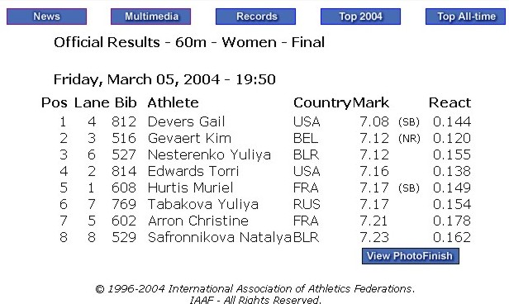
Speed ability
Reaction
Stimulation
Response:
Action-realization:
Unrepeated
Repeated
- acceleration
visual simple - frequency
0.19-0.21s complex - with a change of direction
auditory
0.15-0.16s - simple movement
touch - movement act
0.14-0.15s

Slide 3
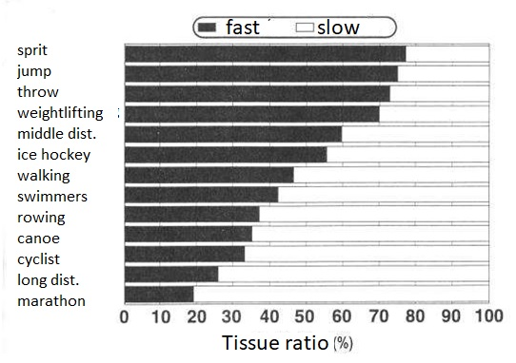

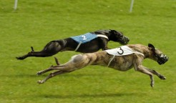
Biological basis of SA
Muscle
ATP and CP supplies
Type of muscle fibeSA
Mobility
Genetic conditionality
Nervous system
Quality of nerve pathways
Receptor and effector sensitivity
Current state, etc.

Slide 4
SA diagnostics
Action-implementation SA
Body parts: Tapping, HK, DK
Comprehensive: Running 50, 20 m. Shuttle run - variants, running on site
Reaction SA
Capturing a flat scale hand, foot
Capturing a falling gymnastic bar

Slide 5
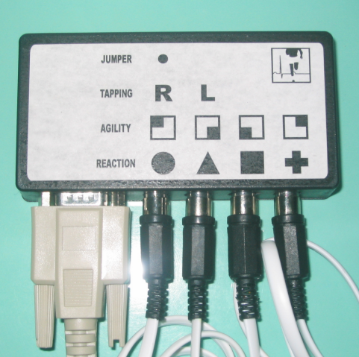
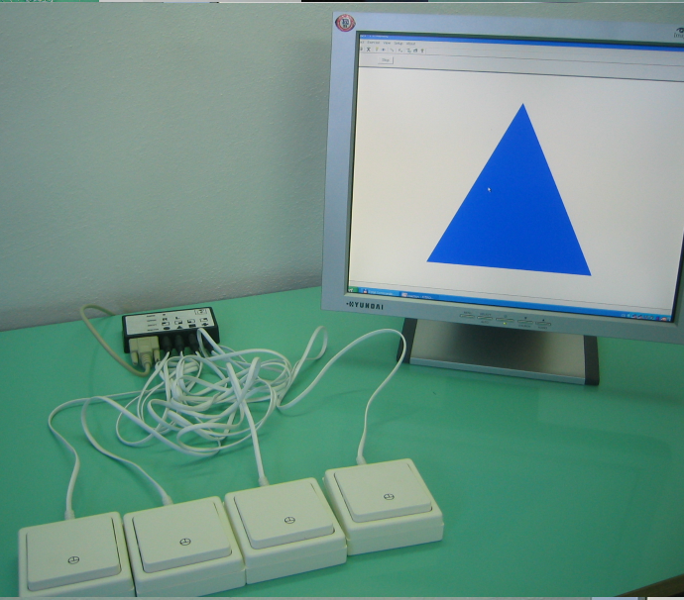
Reactometry
Reaction Check, SW reaction ver 1.0
Agility, Speed ​​check

Slide 6
Methods development SA
Activity intensity maximal
Load duration up to 10 - 15 s.
Number of repetitions in one series 10 - 15
Length of recovery intervals in the series 2-3 min
Number of series 3 (after 4-5 exercises)
Duration of recovery intervals between series 2-5 min (slightly extended after each series)
The nature of activity in recovery intervals active

Slide 7
Speed ​​barrier
extinction
breakage
parallel development of absolute power

Slide 8
Methods of development of reactive MS
Repetition
Analytical
Sensory

Slide 9
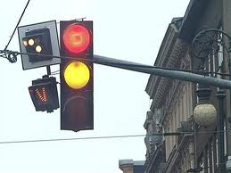
m. repetition
The principle is to repeat the exercise as quickly as possible to a specific signal. This can be expected or unexpected.
Example:
Hand response by pressing acoustic button reactometer. At the acoustic stimulus, the exerciser presses a buttonreactometer.
Number of repetitions: 20 (with different distances between signals within 5 s)
Number of series: 1

Slide 10
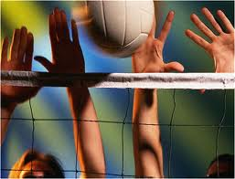
m. analytical
It presupposes the division of the movement structure into sub-parts and the stimulation of these parts separately.
Example:
The player jumps at the time of seeing the ball.
Number of repetitions: 8
Number of series: 3
Rest interval between sets:
2 minutes.

Slide 11
Methods of acyclic MS development
Repetition
Speed
Contrasting
Plyometric

Slide 12
m. repetition
Repetition of physical exercises with maximum speed, when the rest interval ensures a relatively full resumption of activity to the initial level.
Example:
Punches the edge of a hand into a punching bag.
Intensity: maximum.
Number of repetitions: 10x.
Number of series: 5.
Rest interval between sets: 2 minutes.

Slide 13
m. speed (speed force, dynamic efforts)
Medium resistance (30 - 60% of maximum). This range ensures both the application of the force aspect, as well as the fulfillment of the conditions for fast movement and the assumption of fast fiber stimulation.
The speed of the exercise is therefore high to maximum
The number of repetitions is between 6 - 12.
Exercise time should not exceed 15 s
The speed should not fall below 50% of the speed of the same movement without resistance. This also determines the number of repetitions, which has an individual character. Decrease
speed below 50% is a signal to end the exercise (Dovalil, 2002).
Example:
Repeated blocking jump with 10 kg vest.
Intensity: maximum.
Number of repetitions: 6x
Number of series: 5
Rest interval between sets: 2,2,3,3 minutes.

Slide 14
m. contrasting (variable action)
IN framework one training units se they take turns various resist sizes.
Example:
Squat with a barbell on the back - we alternate a series with a weight of 60% of a maximum of 5 repetitions. With a series of 40% maximum 10 repetitions.
We can also change the weight during the series and adjust the number of repetitions accordingly.
Intensity: maximum.
Number of repetitions: 5 resp. 10
Number of series: 5
Rest interval between sets: 2,3,3,3 minutes.

Slide 15
Methods of cyclic SA development
repetition
analytical
m. based on mitigation of conditions
m. load contrast
m. with acceleration

Slide 16
Methods of developing the speed of a complex movement act
reducing space-time boundaries
repetitive
analytical
synthetic
mitigation of conditions
load contrast
Specifically, see the recommended literature -

Slide 17
Youth…
We build SA as a priority throughout the year
already in preparation- (sensitive period)
basically not after loading and fatigue, there is a risk of incorporating incorrect habits)
high exercise intensity (competitiveness)
Don't be afraid to leave the hall and enclosed spaces, even mentally it will help
not two SA development training units in a row

Slide 18
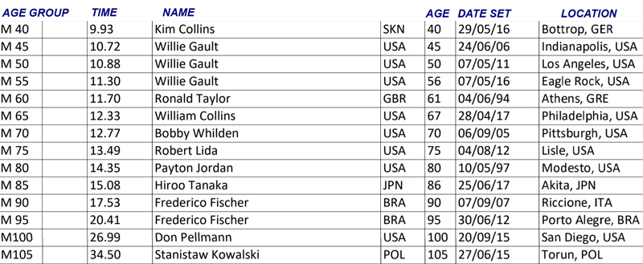
Master 100m world records by ascending age
Source: World MasteSA Athletics Association (as at March 2018)
https://www.peakendurancesport.com/endurance-training/masteSA/sprint-training-speed-age/

Slide 19
https://dinosaurusblog.wordpress.com/2008/08/31/718667-jak-je-to-s-nejvyssi-rychlosti-cloveka/

