Slide 1
Endurance abilities (EA) (Ausdauerfandhigkeit)
The ability to perform repetitive activity of submaximal, medium and mild intensity without reducing its effectiveness. (ČelikoEAký, 1990)
Ability to resist fatigue (Dovalil, 1991)
The complex of assumptions to perform the activity at the required intensity as long as possible, or as high as possible in the allotted time. (Dovalil, 2002)

Slide 2
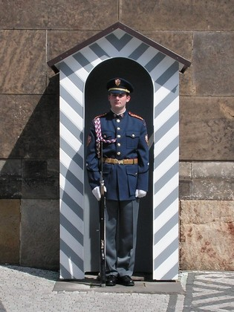
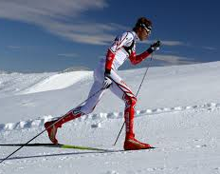
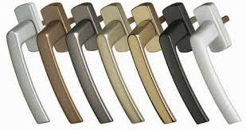
EA - structural aspect
local global
static dynamic static dynamic

Slide 3
EA division - time and energy aspect
speed: up to 20-30 s (ATP - CP system)
short-term: up to 2-3 min (La system)
medium term: 8– 10 min (O2 system)
long-term:
I 10 - 35 min (glycogen)
II 35 - 90 min (glycogen + fats)
III 90 - 6 hours (fats)
IV over 6 hours (protein)

Slide 4
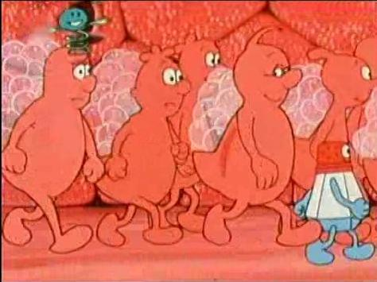
Biological basis of EA
1. Genetic conditioning (muscle fiber ratio)
80%
2. Cardiopulmonary system
respiratory system (tidal volumes, VE, VO2max)
- circulatory system (min. cardiac volume)
- vascular supply to the muscle
⬇⬇

Slide 5
Capillaries (C) - supply of muscle and energy. substrates
Average number of capillaries per 1000 μm2 of muscle cross-section
- in an untrained person 0.84
at the average trained 0.94
for endurance trained 1.25.
(Wilmore & Costill, 1988)

Slide 6
3. energy systems
1) Creatine phosphate system (ATP - CP) - stock for 2-20 contractions
2) Anaerobic glycolysis (La - system) - formation of ATP and lactate
3) Aerobic glycolysis (O2 system) - formation of ATP, CO2 and H2O

Slide 7
2. Glycolytic method of energy release (Anaerobic - lactate system, anaerobic glycolysis, non-oxidative phosphorylation):
glucose (glycogen) → 2 LA + 2 ATP
3. Aerobic system (Krebs cycle, oxidative "aerobic" "slow" phosphorylation)
glucose (glycogen) + O2 → CO2 + H2O + 36 ATP
unsaturated fatty acids + O2 → CO2 + H2O + 129 ATP
pyruvate + O2 → CO2 + H2O + 15 ATP

Slide 8
EA diagnostics
UNIFITTEST: 12 min run, endurance shuttle run, 2 km walk
Holistic motor test (Jacík)
Endurance in the squat, in the bend of the seven, in the supine position of the lower leg
Shyby, cranks prednožování, leh-sed.
Functional stress diagnostics (step tests, spiroergometry)

Slide 9
Methods development EA
Activity intensity
Load duration
Number of repetitions in one series
Length of recovery intervals in the series
Number of series
Duration of recovery intervals between series
The nature of activity in recovery intervals

Slide 10
EA development methods
1. Methods of continuous loading
- continuous method
- alternating method
- fartlek
- control method
2. Methods of intermittent loading
- Extensive interval methods
- Intensive interval method

Slide 11
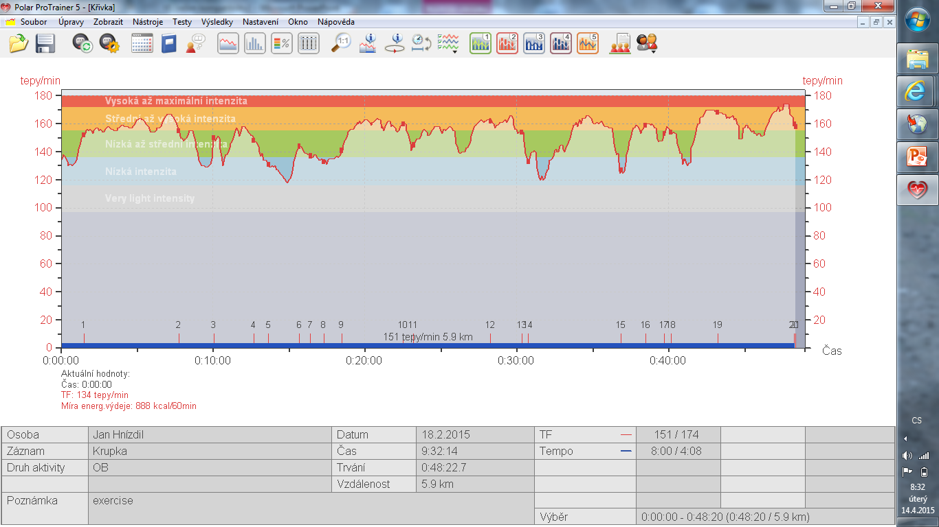
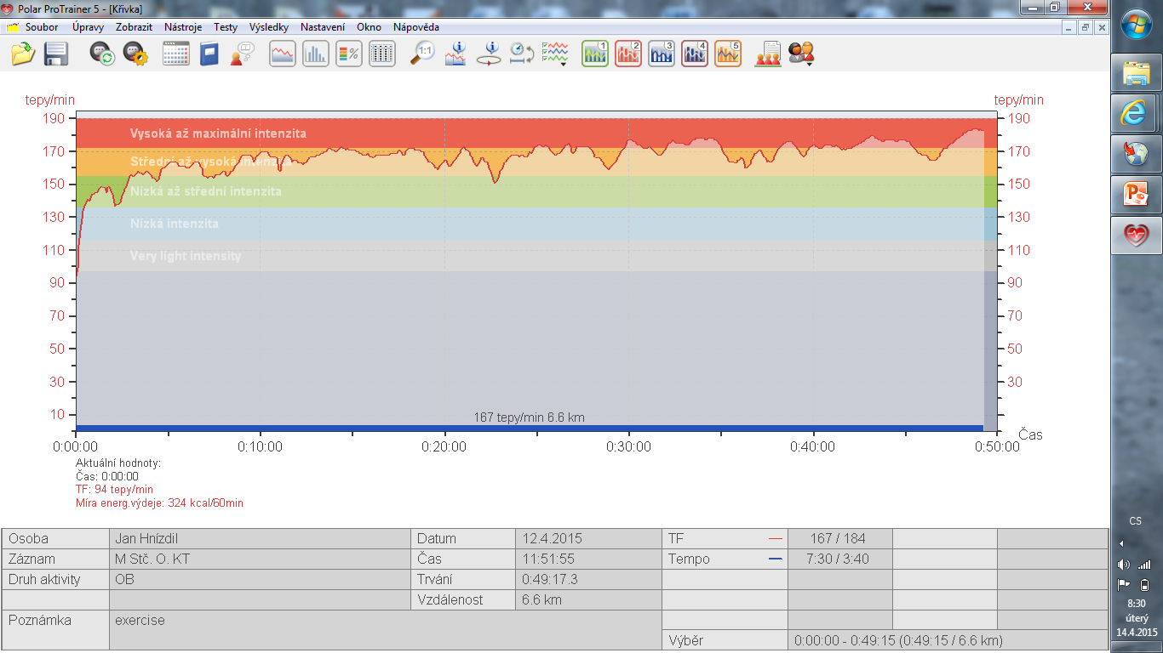
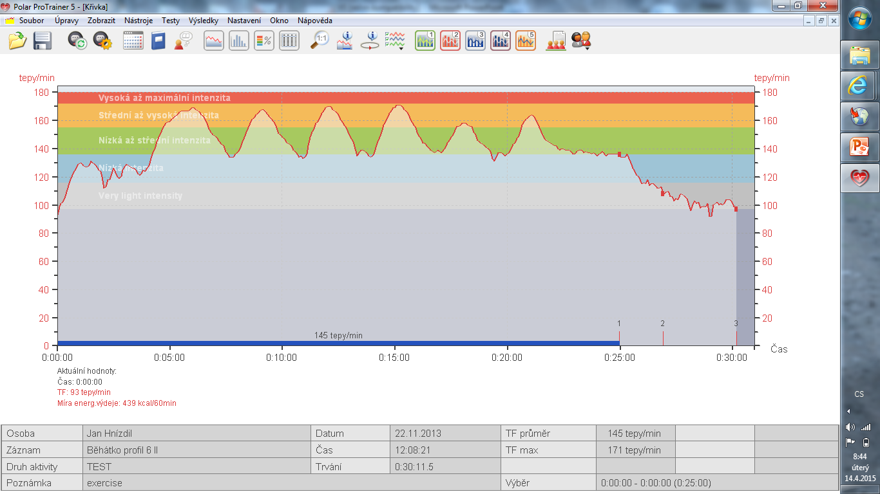
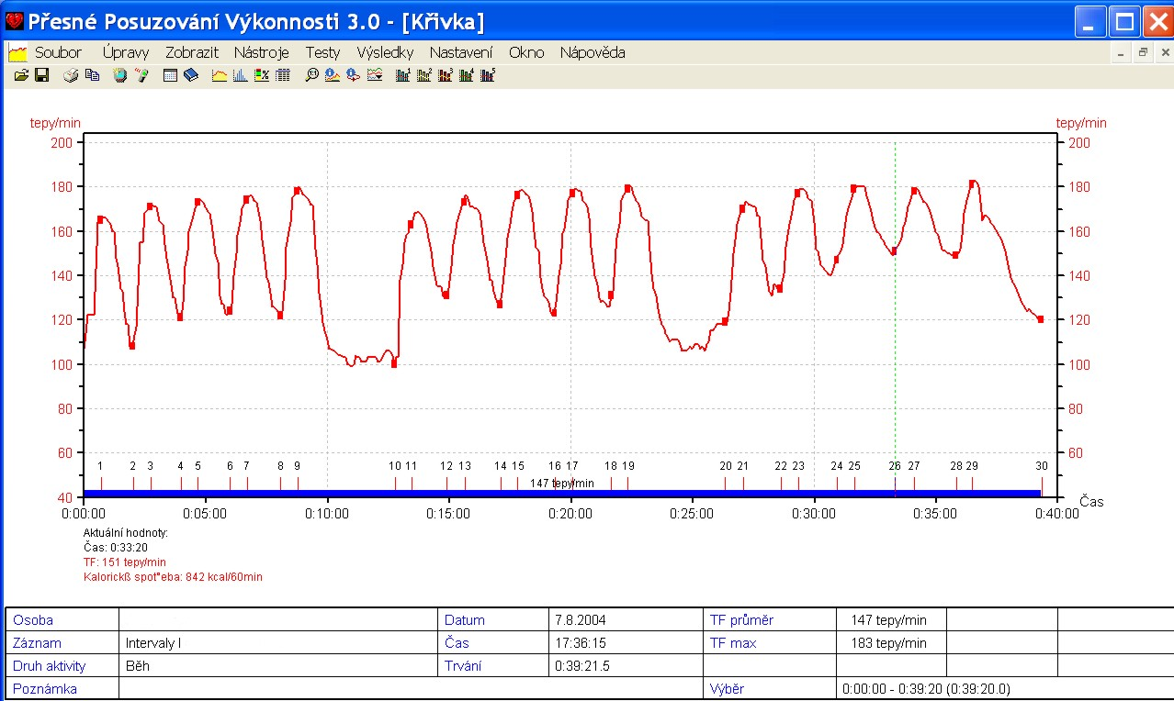
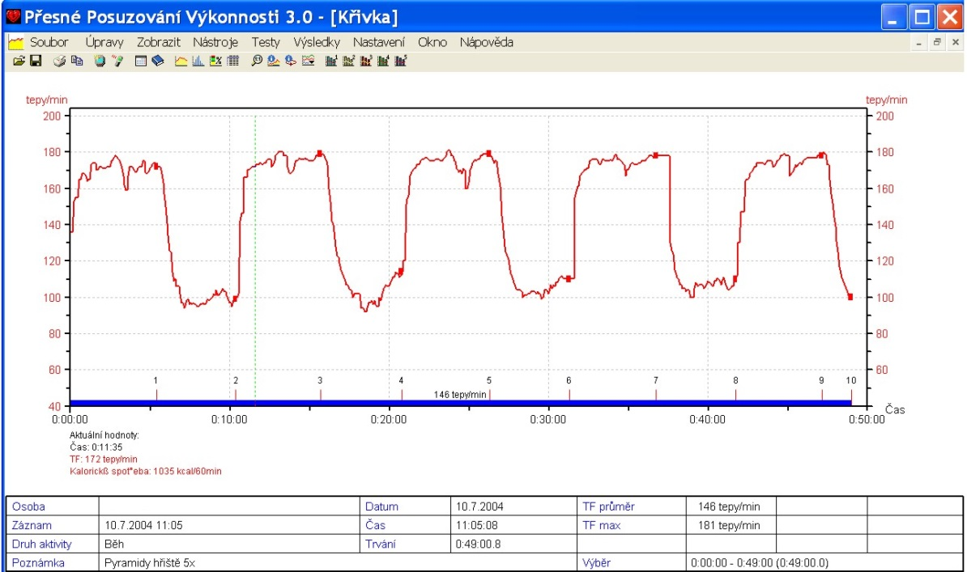
Continuous Fartlek
Alternating
Intensive intervals Extensive intervals

