Slide 1
Motor skills
Motor skills are the general capacities of an individual, manifested in the results of physical activity, otherwise they are hidden, latent (Měkota 2007).
strong
speed
perseverance
coordination

Slide 2
Structure of presentations
definition
structure
biological basis
diagnostics
development (including methods that is the most important thing)

Slide 3
Relationship between movement skills and abilities
congenital X obtained
the relationship is reciprocal and reciprocal
skills are developed in the process of acquiring skills
skills are generalized, skills task-specific
the number of abilities is limited (50), the number of skills is infinite

Slide 4
Strength skills
The ability to move, maintain, or inhibit resistance by muscle contraction in a dynamic or static mode of muscular activity.

Slide 5
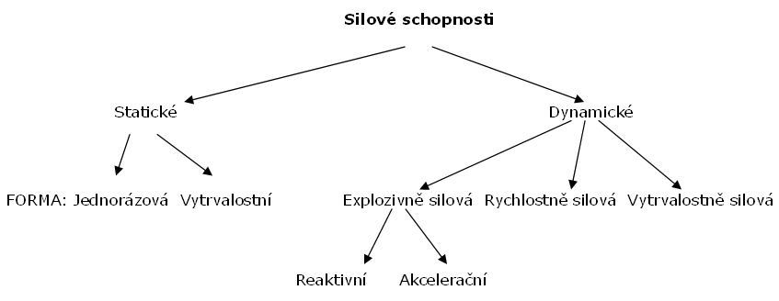

Slide 6
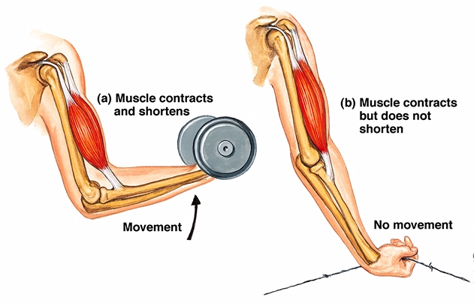
Types of contractions:
(a) isometric - there is no muscle shortening
b) concentric - there is a shortening of the muscle and movement towards the body
c) eccentric - there is an elongation of the muscle and movement away from the body

Slide 7
maximal
(absolute)
speed
(dynamic)
endurance

Slide 8
Biological basis
a) cross section of muscle resp. cross-sectional ratio of fast and slow fibers
b) intramuscular coordination - number of activated (innervated) motor units - speed of their connection and synchronization in time
c) intermuscular coordination - interplay of muscles decisive for performing movement (reaching the maximum at the same time) and at the same time relaxing antagonists
d) reserves of energy resources and their mobilization, enzymatic activity
e) elasticity of muscles and tendons

Slide 9
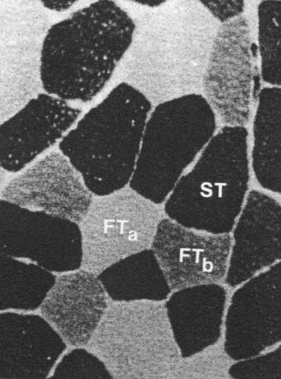
Biological basis

Slide 10
Diagnostics
Tests:
the maximum size of the overcome resistance.
maximum number of repetitions with appropriate resistance.
distance or height covered.
other characteristics using instrumentation
(speed of movement, magnitude or speed of force)
Dynamometry

Slide 11
Basic training requirements for individual types of strength:
Absolute force → high resistance
Fast and explosive force → high speed,
Endurance strength → high number of repetitions

Slide 12
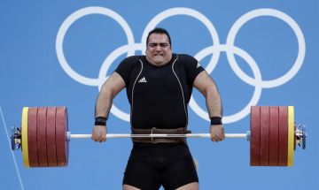
Methods using maximum resistances:
and) method maximum effort (weightlifting)
b) method eccentric effort
C) method isometric

Slide 13
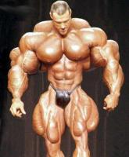
Methods using non-maximum resistances overcome by non-maximum speed:
and) repeated effort method (bodybuilding)
b) isokinetic method
C) intermediate method
d) endurance method
e) mpyramid etode

Slide 14
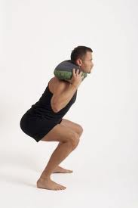
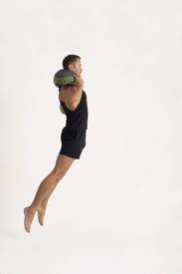
Methods using non-maximum resistances overcome by maximum speed:
a) m. plyometric
b) m. speed (dynamic effort)
c) contrasting m
d) round training.

Slide 15
Method-forming factors (applies to all methods of development of all motor skills = to be able to specifically apply)
Activity intensity
Load duration
Number of repetitions in one series
Length of recovery intervals in series
Number of series
Duration of recovery intervals between series
The nature of activity in recovery intervals

Slide 16
Taken over: Zicháček 2007
Method | The predominant effect
 | Abs. | R, Exc | Endurance | Hyp | Young | Ex
Maximum us | X |  |  |  |  | X
Repeated accounts | X |  | X | X | X
Speed |  | X |  |  | X
Contrasting |  | X |  |  |  | X
Isometric | X
Intermediate | X |  |  | X
Brakes | X |  |  |  |  | X
Isokinetic | X |  |  |  |  | X
Plyometric |  | X |  |  |  | X
Endurance |  |  | X |  | X
The electric stimulus | X |  |  | X

Slide 17
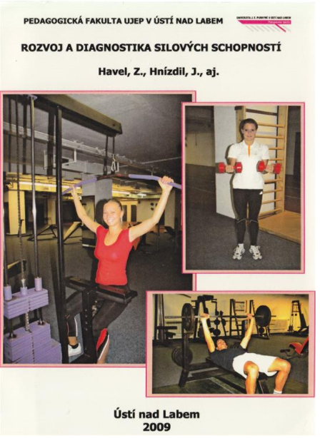
Study literature
https://pf.ujep.cz/~hnizdil/Publikace/Sila_web.pdf

Slide 18
Endurance skills (endurance abilities, Ausdauerfandhigkeit)
Ability to perform repetitive activity of submaximal, medium and mild intensity without reducing its effectiveness. (Čelikovský, 1990)
Ability to resist fatigue (Dovalil, 1991)

Slide 19
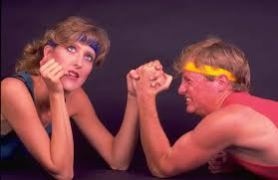
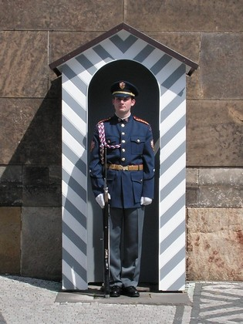
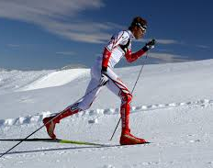
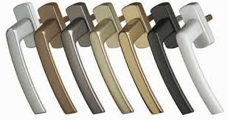
Breakdown VS - structural aspect
local global
static dynamic static dynamic Quantcast

Slide 20
VS division - time and energy point of view
speed: up to 20-30 s (ATP - CP system)
short-term: up to 2-3 min (La system)
medium term: 8– 10 min (O2 system)
long-term:
AND 10 - 35 min (glycogen) II 35 - 90 min (glycogen + fats)
III 90 - 6 hours (fats)
IV over 6 hours (protein)

Slide 21
Biological basis of VS
1. Genetic conditioning (muscle fiber ratio)
80%
2. Cardiopulmonary system
- respiratory system (tidal volumes)
- circulatory system (min. cardiac volume)
- vascular supply to the muscle

Slide 22
VS diagnostics
UNIFITTEST: 12 min run, endurance shuttle run, 2 km walk
Holistic motor test (Jacík)
Endurance in the bend, in the bend seven, in the forefoot lower humiliate
Shyby, cranks prednožování, leh-sed.
Functional stress diagnostics (step tests, spiroergometry)

Slide 23
VS development methods
1. Methods of continuous loading
- continuous method
- alternating method
- fartlek
- control method
2. Methods of intermittent loading
- Extensive interval methods
- Intensive interval method

Slide 24
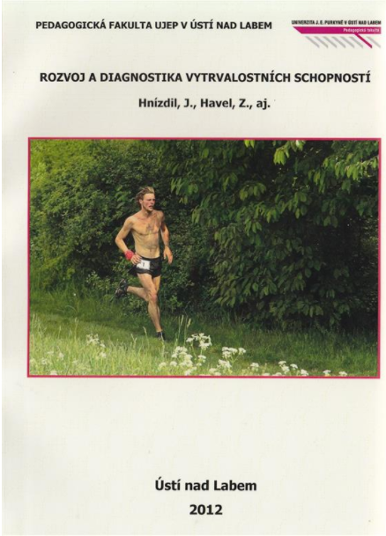
Study literature
https://pf.ujep.cz/~hnizdil/Publikace/VS%20monografie%20komplet.pdf

Slide 25
Speed ​​abilities (speed, Quickness)
Ability to perform a motor activity or perform a certain movement task in the shortest possible period of time. At the same time, it is assumed that the activity is rather short-term in nature (max. 15 to 20 s), it is not too complex and coordinatingly demanding and does not require overcoming greater resistance. (Čelikovský, 1990)
Ability to perform motor activity or perform a certain movement task in the shortest possible time (Kovář in: Čelikovský 1990).

Slide 26
RS structure
Cyclic
Acyclic
Complex
RV
ST

Slide 27
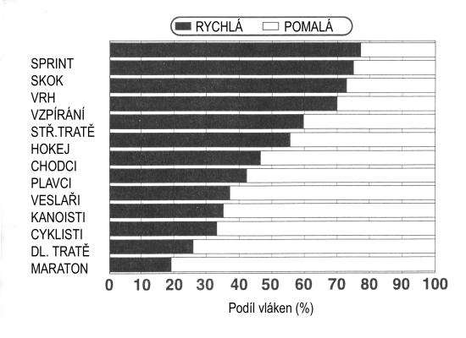
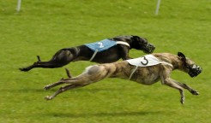
Biological basis of RS
Muscle
ATP and CP stocks
Type of muscle fibers
Mobility
Genetic conditionality
Nervous system
Quality of nerve pathways
Sensitivity of receptors and effectors
Current state, etc.

Slide 28
RS diagnostics
Body parts: Tapping, HK, DK
Comprehensive: Running 50, 20 m. Shuttle running - variants, running on site

Slide 29
Methods development RS
Activity intensity maximal
Load duration up to 10 - 15 s.
Number of repetitions in one series 10 - 15
Length of recovery intervals in series 2-3 min
Number of series 3 (after 4-5 exercises)
Duration of recovery intervals between series 2-5 min (slightly extend after each series)
The nature of activity in recovery intervals active

Slide 30
Methods of development of acyclic MS
Repetition
Speed
Contrasting
Plyometric

Slide 31
Methods of cyclic RS development
repetition
analytical
m. based on mitigation of conditions
m. load contrast
m. with acceleration

Slide 32
Methods of developing the speed of a complex movement act
repetitive
analytical
synthetic
mitigation of conditions
load contrast
reducing spatiotemporal boundaries

Slide 33
Youth…
We build RS as a priority throughout the year
already in preparation- (sensitive period)
basically not after loading and in fatigue, there is a risk of incorporating incorrect habits)
high intensity of exercise (competitiveness)
Don't be afraid to leave the hall and enclosed spaces, even mentally it will help
not two RS development training units in a row

Slide 34
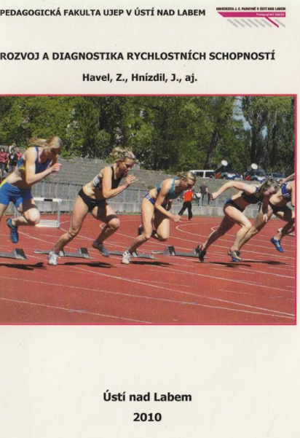
Study literature
https://pf.ujep.cz/~hnizdil/Publikace/Rychlost_web.pdf

Slide 35
Coordination skills
Ability to accurately implement complex spatiotemporal structures of motion. This motor ability is closely linked to the problems of motor control and regulation (Chytráčková, 1988)
Ability to bring the actual course of movement closer to the model (ideal) shape. Ability to solve the spatial and temporal structure of motion.

Slide 36
Biological basis of KS
Analyzers Type I:
(a) visual
b) auditory
c) vestibular
d) kinesthetic
E) somatosensory
f) time
Analyzers Type II:
a) muscle spindles
b) Golgi bodies
c) Ruffini bodies
d) Paccini bodies
e) joint receptors

Slide 37
KS diagnostics laboratory X field
individual components (differential, equilibrium, rhythmic, orientational)
overall KS testing:
1) complexity of movement
2) accuracy of movement
3) speed of completion of the given movement task
4) docility (docility)
5) preservation

Slide 38
Overview of basic motor tests:
Speed ​​performance: running with a disc, set with a rod, test 4x10 with metering
Equilibrium with.: cephalography, stability, endurance standing single-legged
Rhythmic s .: rhythm chart, non - rhythmic drumming, skipping ropes in const. time
Orienteering - vertical jump with maximum angle, basket shooting
Reaction - reactometry
Pooling - repeated assembly with a bar

Slide 39
General principles of KS development
1) high volume of repetitions, reasonable intensity, at a qualitatively high level
2) from the simplest to the most complex exercises (boiler .... double somersault)
3) from constant conditions to variable ones (inside, outside, or after various elements)
4) perform exercises in various variations (boiler in 100 ways)
5) practice combinations of previously mastered and perfectly mastered elements (links)
6) perform exercises under pressure (time pressure, decision making, ...)
7) exercises with additional information: limiting or, conversely, highlighting the function of one of the analyzers (blindfolded exercises, exercises of more complex - asymmetrical movements in front of the mirror).

Slide 40
Development methods
analytical
contrast
repetition
alternating
sensory

Slide 41
The importance of flexibility
successful mastery of movement technique
greater economy of movement
aesthetic form of movement expression in some sports
less likely to be injured or injured
prevention of defects in posture
affecting other motor skills
seamless physical activities in everyday life (Pistotnik, 1998)

Slide 42
Biological prerequisites
agonist X antagonist
reciprocal innervation
skeletal muscle proprioreceptors - Golgi bodies and muscle spindles

Slide 43
Flexibility methods of development
M. active dynamic exercises
M. active static exercise
M. passive dynamic exercises
M. passive static exercise
M. contraction-relaxation-stretching
Stretching - active, dynamic, static, passive: 3 PHASES

Slide 44
Principles for stretching by active static exercise
Warm up (5 min)
Release
Disabling the anti-gravity function
Pain = pathological burden from the periphery
Slowly, pull
Constant free control, targeting.
Stamina
Antagonist contraction (reciprocal innervation)

Slide 45
Diagnostics
goniometry
distance measurement
scaling
motor tests - binary testing
physiological standard (hypo-, hypermobility)

Slide 46
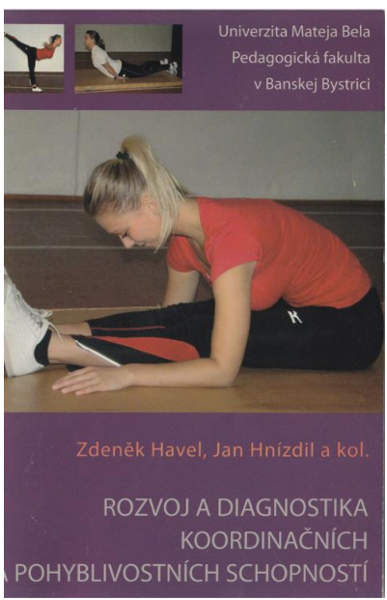
Study literature
https://pf.ujep.cz/~hnizdil/Publikace/Koordinace_web.pdf

